Slide 1






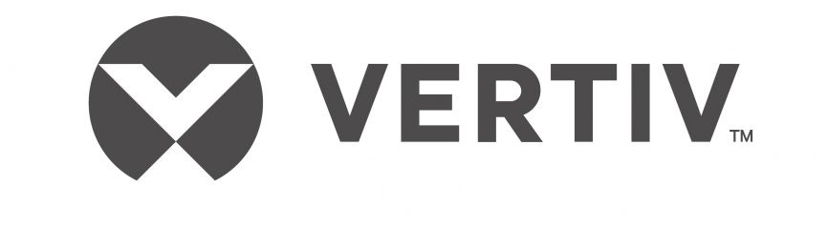
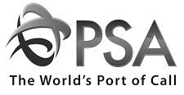








PROJECT GENEVA
AN opportunity to acquire a leading logistic company in Singapore
Private and Confidential
Leading Integrated Warehousing and Logistics Solutions
Geneva is a leading provider of integrated warehousing and logistics solutions as well as other strategic investments. The company has been listed on the Catalist Board of the Singapore Exchange Securities Trading Limited since 2003.
Additionally, Geneva Logistics provides support services for Singapore's port operations.
Geneva Logistics has 4 warehouses in Singapore, the total warehousing storage space is about 707,669 square feet (“ft²”) and the average occupancy rate is about 96%.
Modern and State-of-the-Art Warehousing Facilities
Integrated Supply Chain Solutions
Extensive Facilities
Semi-automated warehouse with 707,669 ft² storage and 206,000 ft² open yard space for comprehensive B2B logistics.
Warehousing | Marine Logistics
Freight | Port Management
Transportation | Chemical Logistics
Customer-Oriented
Offers cost-effective, efficient services, building a broad customer base with comprehensive logistics solutions.
Advanced Equipment
Features state-of-the-art material handling equipment and up-to-date safety and security.
IT Integration
Uses IT to enhance order visibility, and operational efficiency, and reduce supply chain costs, supporting Business to Consumer (“B2C”) solutions.
Global Third Party Logistic to Reach USD 1.44 Trillion by 2028 (USD’ Trillions)
Key Growth Drivers
E-commerce Expansion | The explosive growth of online shopping has significantly increased the demand for logistics services, particularly in warehousing and inventory management.
Rise in globalisation | As businesses expand their operations across international borders, they increasingly rely on 3PL providers to navigate complex global trade dynamics.
Focus on Core Competencies | Many companies are choosing to outsource logistics functions to 3PL providers to focus on their core businesses.
Source(s): Fortune Business Insights
Strong Financial Performance (SGD ‘million)
Renowned Key Customers
Key Investment Merits
Highly Experienced Management Team | Geneva is led by a management team that have extensive years of relevant experience in the warehousing and logistics business as well as management of large companies.
Growth Potential in Logistics Sector | The logistics and warehousing sector in Singapore is poised for growth due to increasing trade activities and the strategic importance of Singapore as a global logistics hub.
Strong Reputation in the Logistics Industry | Geneva has a solid reputation in the industry known for delivering quality and reliable services which will help to increase exposure and reach out to a greater number of existing and potential customers.
Robust Growth for GKE Logistics | Geneva demonstrates robust revenue growth and profitability, boasting an 11% CAGR in revenue and a significant 16% year-over-year increase in EBITDA in FY2023 as compared to FY2022.
Comprehensive B2B Logistics Capability | Geneva has a diverse portfolio of warehousing and logistics services and solutions that complements each other to offer customers a comprehensive supply chain management solution.
Renowned Customer Base | Geneva’s key customers, that spread across various industries, are large MNCs and GLCs.
All rights reserved 2024

Slide 2
PROJECT GENEVA
AN opportunity to acquire a leading logistic company in Singapore
Private and Confidential
Median EV/EBITDA (LTM) of 8.1x for Selected Logistic Companies listed on SGX-ST and HKEx
Median EV/EBITDA:
8.1x
Company Name | Geneva – Adjusted⁽¹⁾ | China Infrastructure & Logistics Group Ltd.⁽²⁾ | Infinity Logistics and Transport Ventures Limited | EDA Group Holdings Limited | ANE (Cayman) Inc | Vibrant Group Limited | World-Link Logistics (Asia) Holding Limited | Chasen Holdings Limited | A & S Group (Holdings) Limited
Geography | Singapore | Hong Kong | Malaysia | China | China | Singapore | Hong Kong | Singapore | Hong Kong
Market Capitalisation (S$ m) | 170 | 224 | 124 | 238 | 1,256 | 41 | 25 | 39 | 20
Enterprise Value (S$ m) | 192 | 296 | 152 | 206 | 1,192 | 104 | 19 | 87 | 6
LTM EBITDA (S$ m) | 25 | 3 | 10 | 17 | 147 | 13 | 12 | (8) | (0)
Notes:
(1) Adjusted EBITDA means EBITDA adding back non-recurring expenses after the completion of acquisitions such as certain management salaries that will not form part of the acquisition.
(2) The above mean and median calculations of EV/EBITDA exclude outliers of China Infrastructure & Logistics Group Ltd.
Source(s): Capital IQ
Salient Terms
Transaction Overview
Transaction Process
Type of Transaction | Divestment of entire logistic unit
Proposed Valuation | S$ 170 million
EV/ EBITDA | 7.8X
Signing of non-disclosure agreement
Receive confidential information memorandum
Meeting with management team
Signing of term sheet
Signing of sale and purchase agreement
Preliminary due diligence
Completion of transaction
All rights reserved 2024

